Slide 1













Lunar Cafe
Natalie Choo & Nikolas Rodriguez

Slide 2





The Concept
2
According to legend, the mystical Lunar Café is said to manifest in the dreams of select students, offering them a magical beverage that helps them on their academic journey…

Slide 3





Our Idea for the Lunar Cafe
3
Summon several adorable Baristas for visitors to choose from and interact with in a choose-your-story video game-like fashion.
Use magic to brew several drinks with different effects tailored to the individual’s desires.
Press [i] to admire the baristas’ talent!

Slide 4
Course Related Topics
4
Transformation Matrices
For both static and dynamic objects
Needed for barista animations
Mobile Eye Spaces
Allows an additional view of the drink
Allows for a closeup view of the rotating star
Textures
Most notably on the drink surface
User interactivity

Slide 5
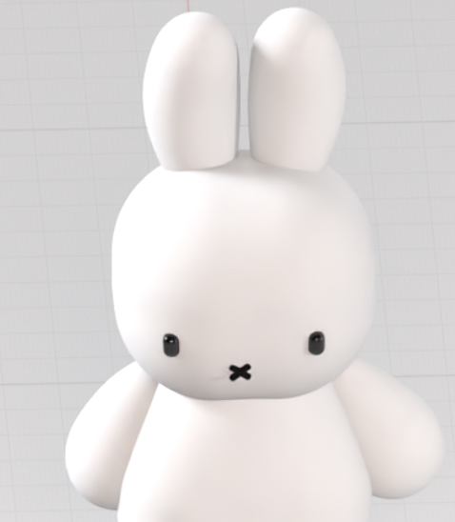
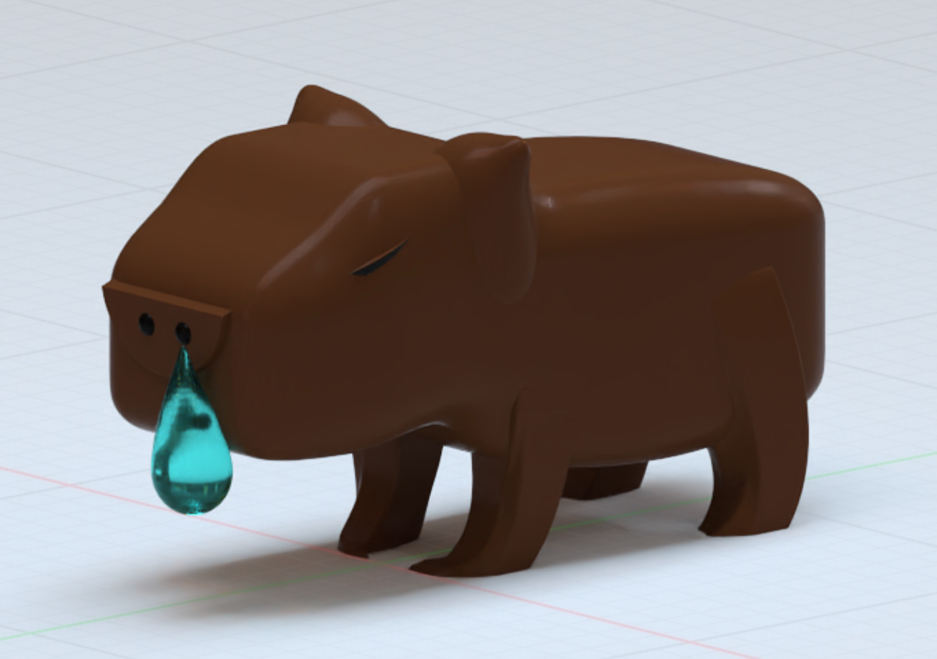
Baristas - Created in womp!
Capy
Miffy
5

Slide 6
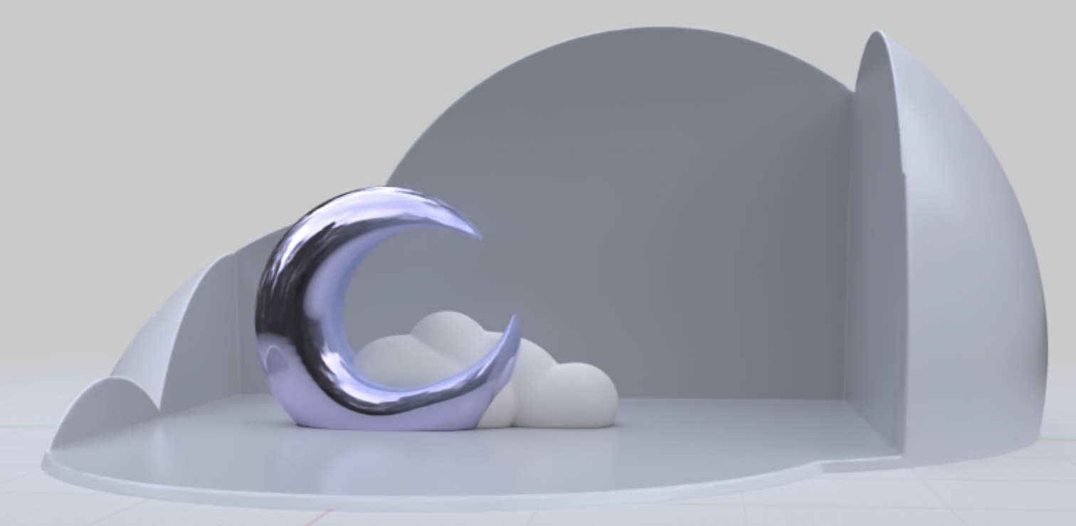
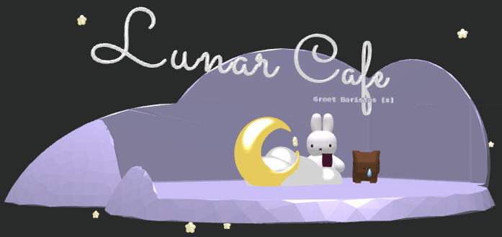
The Cafe:
6
Created in Womp and imported as a shape.
Had to import different parts individually.

Slide 7
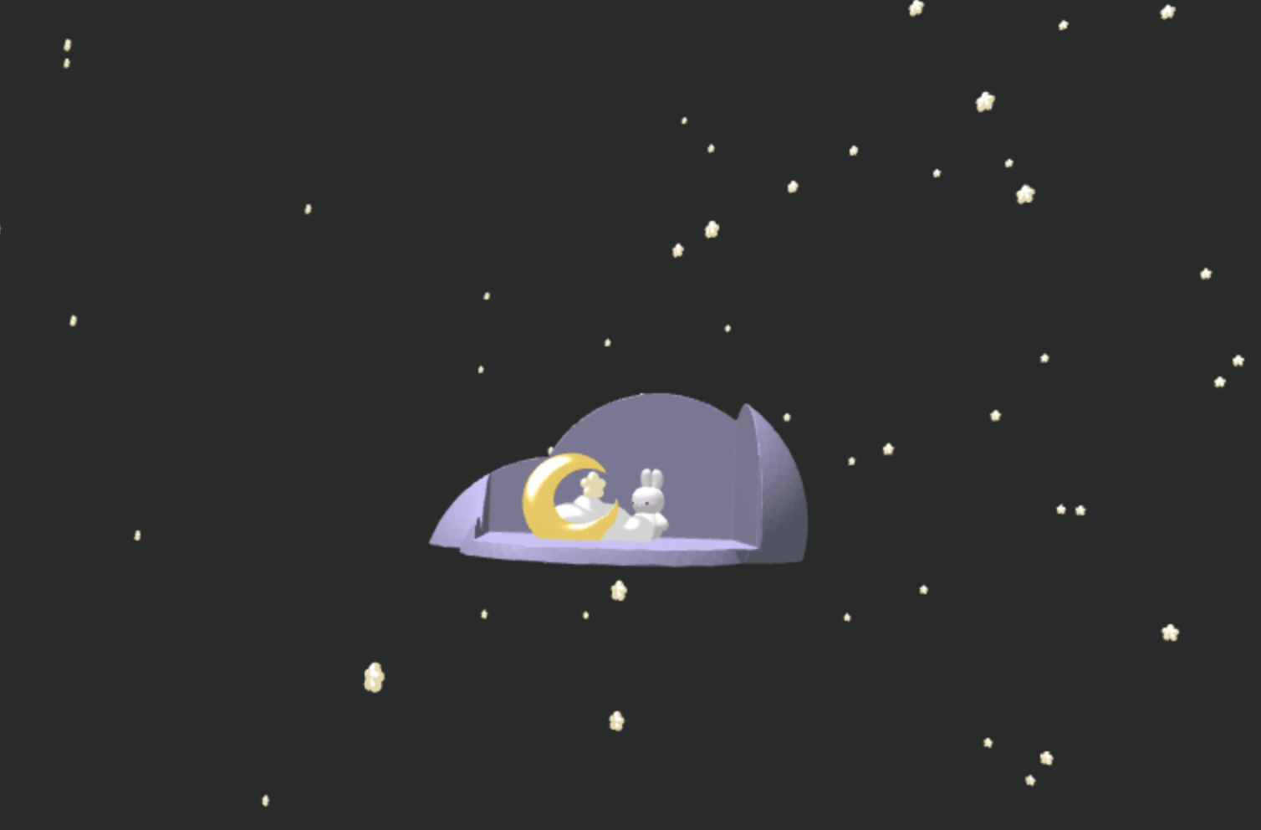
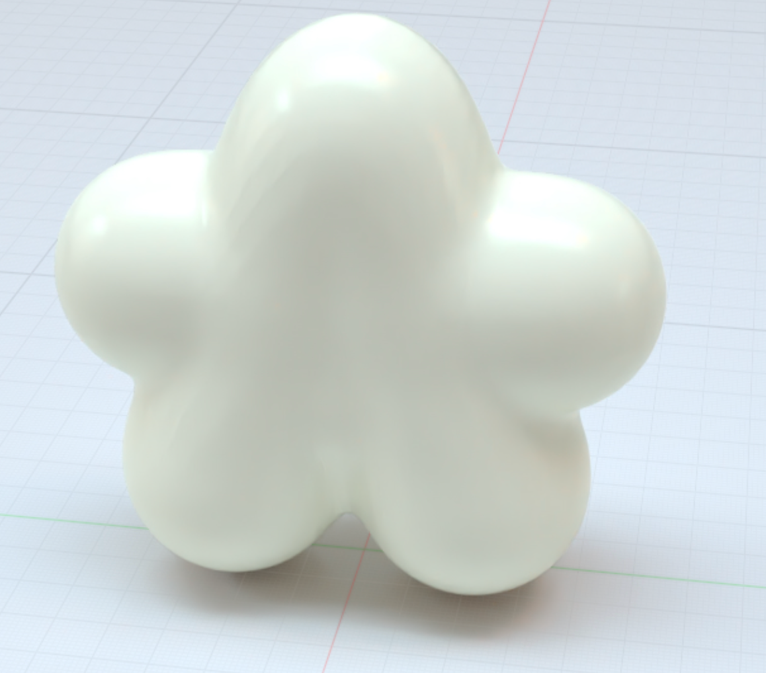
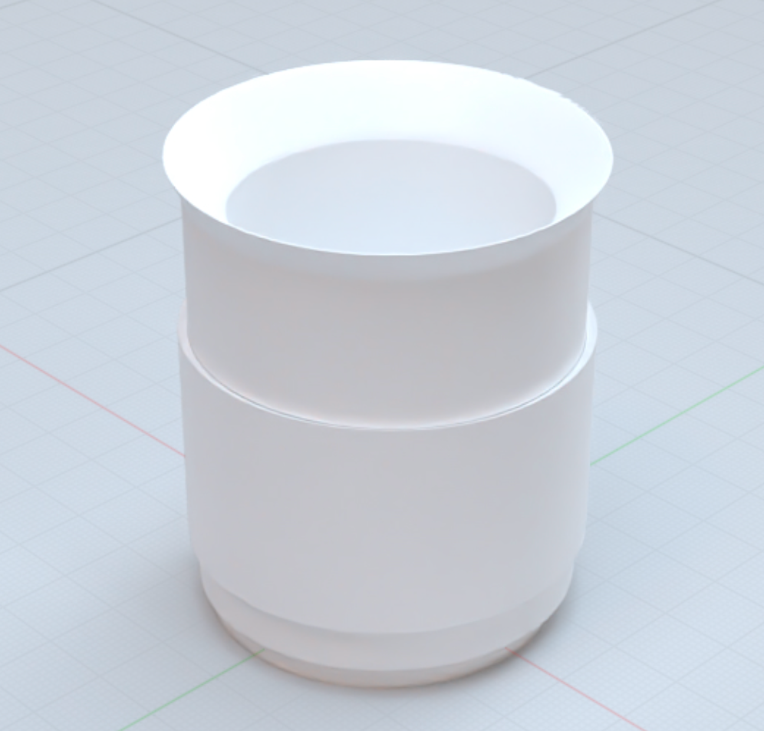
Magical Stars!
7
Created both the stars and the cup in Womp and imported each as a shape
Based on the user’s order, the barista will use magic to transform the magical stars into a drink
We already created an idle animation for the main star in the cafe, and are also using stars as background decoration

Slide 8
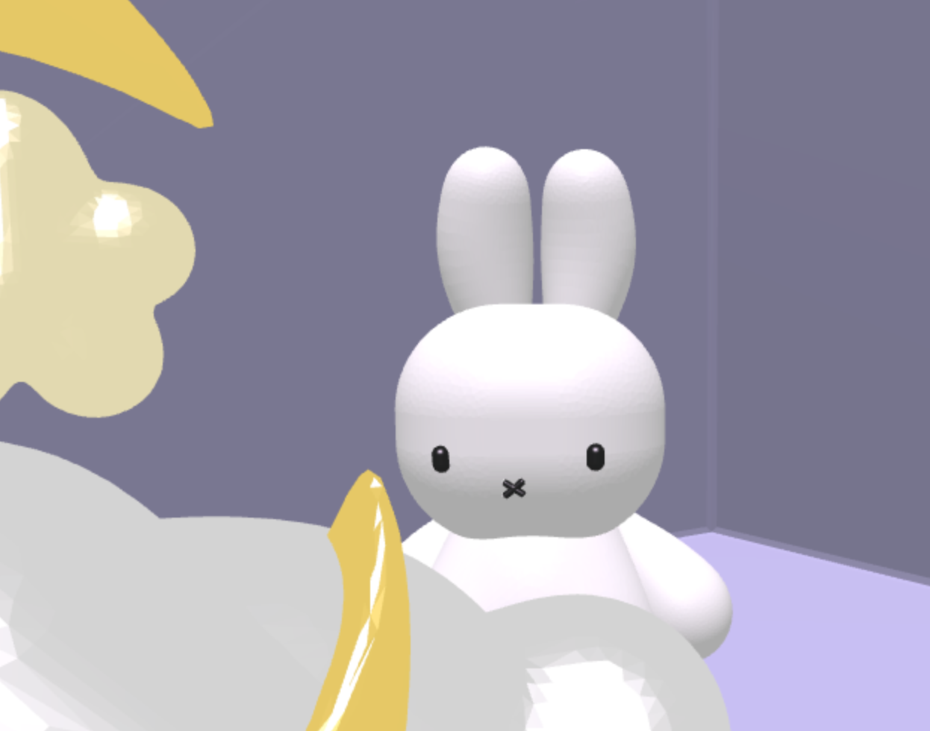
Materials + Coloring
8
As previously mentioned, different parts of the cafe imported as .obj separately.
Moon
Cloud Counter
Miffy’s Eyes
This allowed us to create a custom material for each object.
Could also transform each object separately.

Slide 9
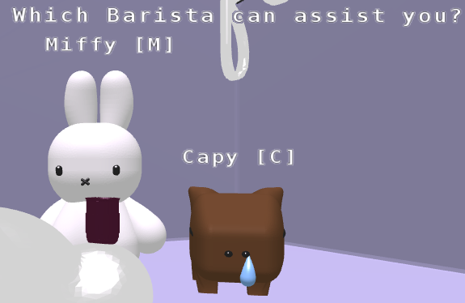
Text (NEW)
9
We made use of the Text_Line class to prompt users to make decisions. (From text-demo.js).
Was a crucial part of our “choose your own path” design.
By default displays the entire string at once.
We implemented logic to “animate” our text - displaying it letter by letter.

Slide 10
Sounds (NEW)
10
Imported mp3 files as Audio elements and created a play_sound() function that plays the correct sound for each scene based on the buttons used
Added another element of user interactivity!
Included unique sounds for:
Background music
Barista voices
Star magic
Drink inspection

Slide 11
Animations (NEW)
11
Added Animations for:
Barista selection
Barista drink-making
Idle star turning
Special star turning
Idle drink spinning

Slide 12
Drinks: Textures & animations (NEW)
12
Imported .png files to add texture to objects like we did in our last assignment
Used the textures to make an aesthetic drink surface
Users can inspect the drink using [i] which will change the view to a birds-eye-view
There is an idle animation of the drink slowly stirring in the cup

Slide 13
Interactivity: (NEW)
13
x : go to next text
Shift + S: Grab the star (only allowed when it’s at max size)
i : Inspect the drink
Shift + B: Go back to drink selection
Shift + G: Choose Green Tea
Shift + L: Choose Latte
Shift + E: Choose Espresso
Shift + M: Choose MIffy as Barista
Shift + C: Choose Capy as Barista

Slide 14
Difficulties
Coloring
Star Animation
Text Animation
14
It was difficult coloring the models since they were exported as a big singular object. We had to redo the way we imported them to color them properly
We wanted the user to interact with the main star. We had trouble enabling the user to collect the star once it was fully grown.
We felt displaying text letter by letter was more visually appealing, so we had to iterate through every string we displayed to give it an “animated” effect.

Slide 15

DEMO

